Slide 1

PHOTO SHOP USING PYTHON
BY
1602-20-737-126 KILLAMSETTY ASISH
1602-20-737-131 GANESH REDDY
1602-20-737-176 Kareenolla Sunil

Slide 2
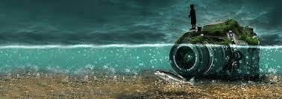
Abstract :
Now a days people are moving into a imaginary world where people only believe what they see but not what is happening in the background like removing orginal background and editing it with new background like waterfalls, Eiffel tower etc.. Our project is about the same thing that is known as photoshop. In this anyone can edit the photo into their convenient way like cropping the image, resizing the image etc…It have so many features that user can make use for many purposes.
This project mainly uses librarys like opencv , pillow, tkinter etc.
“You can photoshop something, put it out, and everyone believes it.”- Keri Hilson

Slide 3
Manipulating the color of an image.
Cropping images.
Repairing flaws, such as dust on the lens or red eyes.
Drawing on an image with a pen or pencil.
Adding text to images.
Removing people or objects within an image.
FEATURES

Slide 4

Similar applications
Yes there are lot similar photo editing apps where we can edit the images by paying some monthly Subscription.
Some similar applications are Snapseed, Adobe photoshop, Pixlr.
But my project is much easy to understand for everyone who use it and it is not much similar to other applications.

Slide 5
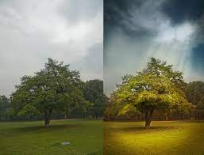
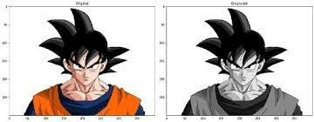
Input and Output:
INPUT:
The input is document file that has image which is needed to photoshop
The program remake and edit the image to user required one.
Output:
The image which contains the marks ,pimples, make the image brighter, etc.. are removed and make the image a beautiful one

Slide 6
Future Scope 🤔:
For image creation and graphic design softwares.
To restore old photos and tradition.
It is also used for Brand Building.
Better sales.

